Slide 2
In The Name of God
The Most Compassionate, The Most Merciful
یـایها الذین ءامنوا... تعاونوا علی البر و التقوی و لا تعاونوا علی الاثم والعدوان(سوره مائده، آیه۲)
“You who believe…cooperate with one another for virtue and heedfulness, and do not cooperate with one another for the purpose of vice and aggression.” (Quran, 5:2)

Slide 3
4th Global Takaful and Retakaful Forum 2022
AlHuda Center of Islamic Banking and Economics (CIBE)
Dr. Ali Bonyadi Naeini
Planning and Development Vice President of the Central Insurance of I.R Iran, and member of the Takaful Task Force of Insurance Research Center (IRC)

Slide 4
Takaful Industry and the Move toward a New Prospect Driven by Solidarity among Islamic Countries

Slide 5
objectives of the current forum:
1
knowledge and benefits of the takaful industry in order to prepare adequate manpower
2
problems hindering rapid development of takaful
3
opportunities for performing takaful operations
ensure greater coordination among various players
4
5
addressing the business development by employing the results of the studies carried out across the world

Slide 6
Takaful
An inseparable part of the global financial industry

Slide 7
significant trends of Takaful industry
in the past few years:
substantial acceleration in the growth of takaful sector and partnership among its key players in the world.
rising global demand for takaful products followed by the extraordinary growth of the various sectors within the Islamic financial system especially Islamic banking and Islamic capital market.
the issuance of sukuk with longer tenure consistent with the investments and long-term liability risk management and completely compliant with the Sharia.
in recent years, many progresses have been achieved in the regulatory domains.

Slide 8
Key challenges in the international development of takaful industry
Small size and limited capacity
The necessity of addressing retakaful
The necessity of addressing the current economic condition
Low penetration rate
Opening new horizons

Slide 9
Takaful's strategic goals
and the ways to achieve them

Slide 10
Section One: Focusing on the Implementation of Takaful and Adaptation of the Islamic Financial System to the Shariah
1
The necessity of identifying the differences between the takaful models with those used in the traditional underwriting procedures and focusing on the emerging features emanated from the implementation of takaful as an Islamic insurance
2
Addressing the compliance with the Islamic principles in regulatory practices and the formulation of operational guidelines as the main factors in fulfilling the satisfaction of the global Islamic community with respect to takaful products
3
Supporting and creating joint ventures and facilitating their setup with the aim of establishing joint takaful and retakaful operators in the Islamic countries

Slide 11
Section Two: Focusing on the International Role of Insurance
Fostering solidarity among the Islamic countries by the establishment of one single model
Addressing the role of insurance in economic, political, and social development
Taking advantage of the agreements and partnerships among Islamic countries and other international and Islamic organizations
Focusing on the outcomes achieved by deploying takaful system with the purpose of promoting cooperation among the participants and fulfilling the social development goals
Founding an all-inclusive retakaful institution that promotes one single model that operates under the international laws among the Islamic countries and at the global level.

Slide 12
Section Three: Business Improvement
01
The necessity of addressing the executive and regulatory infrastructures in performing takaful operations and financing takaful funds
02
03
Creating educational settings and employing professional and efficient workforces
The necessity of addressing the least competencies required to take the executive positions in takaful companies and relevant funds;
04
The development and improvement of the technological infrastructures for both data security and offering knowledge-based takaful products.

Slide 13
By the application of innovative digital technologies, the expansion of insurance and takaful to a wider population with simpler and affordable covers, coupled with the protection solutions that meet the needs of the customer beyond the current traditional covers will be possible.

Slide 14
Section Four: Other notable factors that helps fulfill the future goals
1
Sustainable population growth
Development plans with the aim of creating economic and investment diversity as depicted in the Saudi Vision 2030 and Iranian Islamic Model of Development portrayed in its Vision 1444 (2065) that all of them will likely lead to the growth in the whole region
4
2
Considering the infras-truc-tural developments such as smart cities like NEOM in Saudi Arabia and digital insurance
3
Reopening the tourism sector and mega events such as international fairs like EXPO in UAE or FIFA World Cup at Qatar
5
Pervasive vaccination along with removing some of the pandemic restrictions as catalysts for the economic recovery, despite the warning against the new benign variants of COVID-19.

Slide 15
statistics regarding
the status of takaful business in the Islamic countries

Slide 16
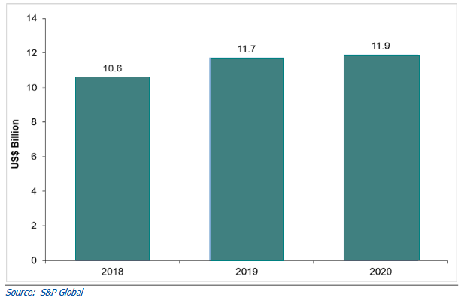
Diagram 1: Gross Written Premium (GWP)
of Takaful Insurers in the GCC Region
The GCC takaful insurance industry largely remained resilient in 2020, despite a fall in motor and medical claims, following imposed restrictions due to COVID-19.

Slide 17
in Saudi Arabia during 2019, takaful contributions rose to 8.8% with its 30 listed insurers delivering a triple-digit growth of 108.1% in net profit before zakat to $331.1 million.
The growth was fueled by the health line following the introduction of mandatory cover for dependents of Saudi nationals and additional benefits under the unified medical policy from July 2018.
The mandatory health coverage was also introduced in Dubai and Abu Dhabi that spurred demands in the industry.

Slide 18
Forecast
The GCC insurance market is expected to grow at an annualized rate of 3.2% from $26.5 billion in 2021 to $31.1 billion in 2026

Slide 19
reinforcing the regulations
promoting the innovative tech-enabled services
along with introducing mandatory business lines
diversifying the economic activities
Will help the growth of gross written premiums (GWP)

Slide 20
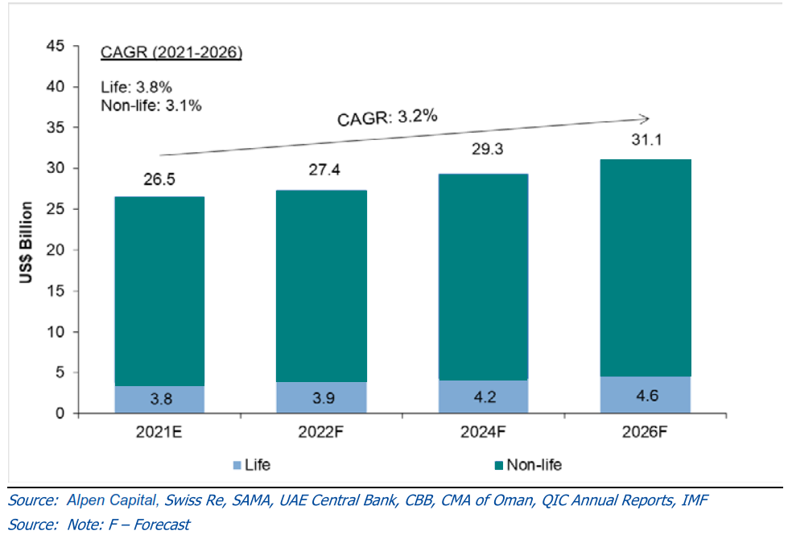
Diagram 2: GCC Insurance Market Size Forecast

Slide 21
Insurance structure and market overview
in Islamic Republic of Iran

Slide 22
Table 1: Overview of economic and insurance indicators in Iran during 2019-2020
Title |  | 2019 | 2020
Economic Indicators | Global Ranking of Iran`s Economy (According to GDP) | 26 | 18
 | GDP (Billion Rial) | 23,853,286 | 34,339,838
 | Population (Million People) | 83.1 | 84.1
Insurance Indicators | Produced Premium (Billion Rial) | 594,653 | 820,289
 | Produced Premium growth rate (percentage) | 30 | 37.9
 | Produced Premium (Billion $) | 12 | 19.3
 | Global ranking of The Insurance industry (According to Premium) | 38 | 33
 | Share of Life Insurance premium | 14.3 | 15.3
 | Insurance Density (Premiums per capita ( (Million Rial) | 7.2 | 9.8
 | Premiums Per Capita ($) | 143 | 229
 | Insurance Penetration (Percentage) | 2.49 | 2.52
Source: insurance industry annual report, CENTRAL INSURANCE OF ISLAMIC REPUBLIC OF IRAN website ,2020

Slide 23
Table 2: Global assessment and comparison of insurance market in Islamic Republic of Iran and in the world
Iran`s Insurance Market | Produced Premium growth rate (percentage) | 30 | 37.9
 | Share of Life Insurance premium | 14.3 | 15.3
 | Premiums Per Capita ($) | 143 | 229
 | Insurance Penetration (Percentage) | 2.49 | 2.52
Global Insurance Market | Iran`s Share of Global Market(percentage) | 0.19 | 0.31
 | Global Produced Premium growth rate(percentage) | 2.20 | 0.04
 | Share of Life Insurance premium in Global Market (percentage) | 45.96 | 44.50
 | Global Premiums Per Capita ($) | 818 | 809
 | Global Insurance Penetration (Percentage) | 7.2 | 7.4
Source: insurance industry annual report, CENTRAL INSURANCE OF ISLAMIC REPUBLIC OF IRAN website ,2020

Slide 24
Produced Premium
Produced Premium means the value of policies, which has been issued by insurance companied during the period of report.

Slide 25
Diagram 3: Produced Premium in insurance industry of Islamic Republic of Iran and the world
Source: insurance industry annual report, CENTRAL INSURANCE OF ISLAMIC REPUBLIC OF IRAN website ,2020

Slide 26
Insurance Penetration Rate
the insurance penetration rate is derived the division of the premium into GDP & expresses the faster or slower movement of the insurance industry compared to the entire country`s economy.

Slide 27
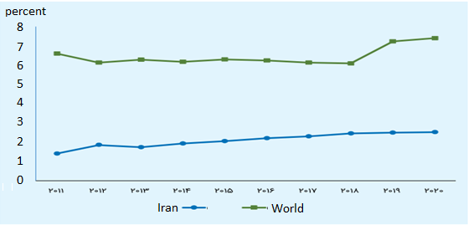
diagram 4: Comparison of this index between insurance penetration rate in Iran and the world in a period of ten-years
source insurance industry annual report, CENTRAL INSURANCE OF ISLAMIC REPUBLIC OF IRAN website ,2020

Slide 28
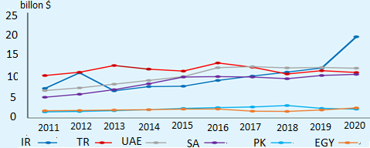
Diagram 5: Comparison of production insurance premiums in the I.R of Iran with Islamic Countries (Egypt, Pakistan, Saudi Arabia, UAE, Turkey & Iran)
source: Insurance industry annual report, CENTRAL INSURANCE OF ISLAMIC REPUBLIC OF IRAN website ,2020

Slide 29
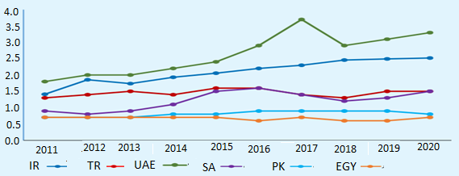
Diagram 6: Comparison of the insurance rate in the I.R of Iran with Islamic Countries (Egypt, Pakistan, Saudi Arabia, UAE, Turkey & Iran)
source: Insurance industry annual report, CENTRAL INSURANCE OF ISLAMIC REPUBLIC OF IRAN website ,2020

Slide 30
Reinsurance authorized capacity
of private insurance companies and Iran insurance company as the only state-owned company

Slide 31
Diagram 4: Total Reinsurance authorized capacity of private insurance companies and Iran insurance company as the only state-owned company
Million Rial
Insurance Company | Paid up Capital | Legal reserve | Capital reserve | Other reserve | Technical reserve with the exception of deferred and mathematical damages reserve | Total capital payments of reserves and Technical Reserves with the exception of deferred and mathematical damages reserve | Authorized capecity,2/4 paragraph, Implementation criteria Article 5 of the by-laws 5/40
Total | 341,685,929 | 7,841,890 | 13,893,279 | 16,597 | 297,004,571 | 660,442,266 | 67,660,659,9
Source: insurance industry annual report, CENTRAL INSURANCE OF ISLAMIC REPUBLIC OF IRAN website ,2020

Slide 32
Summary and Conclusion

Slide 33
that the future prospects of the Takaful industry will be highly dependent on the joint efforts of all relevant parties, especially the competent authorities in Islamic financial and insurance institutions in Islamic countries.

Slide 34
Market players, religious scholars, jurists in both Imamiyyah and public jurisprudence and ultimately in the international community in general, the spirit of brotherhood and helping each other with a sincere intention will bring more blessing from God for the development of this industry and the growth and development of the Takaful industry is more and more visible in the global arena.

Slide 35
At the end, I entrust and ask God for success, prosperity and health along with practical unity and coherence to realize a model based on cooperation in economic development in Islamic countries and the world.

Slide 36
Thank you for your attention

Slide 37
حفظكم الله

